Slide 1

William Stallings Computer Organization and Architecture 9th Edition
Notes:
Lecture slides prepared for “Computer Organization and Architecture”, 9/e, by William Stallings, Chapter 2 “Computer Evolution and Performance”.

Slide 2
Chapter 2
Computer Evolution and Performance
Notes:
We begin our study of computers with a brief history. This history is itself interesting
and also serves the purpose of providing an overview of computer structure
and function. Next, we address the issue of performance. A consideration of the
need for balanced utilization of computer resources provides a context that is useful
throughout the book. Finally, we look briefly at the evolution of the two systems
that serve as key examples throughout the book: the Intel x86 and ARM processor
families.

Slide 3
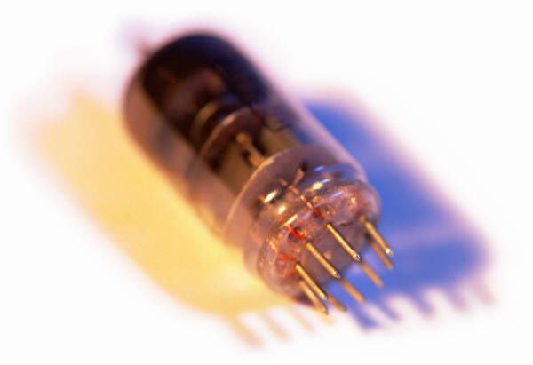
History of Computers
First Generation: Vacuum Tubes
ENIAC
Electronic Numerical Integrator And Computer
Designed and constructed at the University of Pennsylvania
Started in 1943 – completed in 1946
By John Mauchly and John Eckert
World’s first general purpose electronic digital computer
Army’s Ballistics Research Laboratory (BRL) needed a way to supply trajectory tables for new weapons accurately and within a reasonable time frame
Was not finished in time to be used in the war effort
Its first task was to perform a series of calculations that were used to help determine the feasibility of the hydrogen bomb
Continued to operate under BRL management until 1955 when it was disassembled
Notes:
The ENIAC (Electronic Numerical Integrator And Computer), designed
and constructed at the University of Pennsylvania, was the world’s first general purpose
electronic digital computer. The project was a response to U.S. needs
during World War II. The Army’s Ballistics Research Laboratory (BRL), an agency
responsible for developing range and trajectory tables for new weapons, was having
difficulty supplying these tables accurately and within a reasonable time frame.
Without these firing tables, the new weapons and artillery were useless to gunners.
The BRL employed more than 200 people who, using desktop calculators, solved
the necessary ballistics equations. Preparation of the tables for a single weapon
would take one person many hours, even days.
John Mauchly, a professor of electrical engineering at the University of
Pennsylvania, and John Eckert, one of his graduate students, proposed to build a
general-purpose computer using vacuum tubes for the BRL’s application. In 1943,
the Army accepted this proposal, and work began on the ENIAC.

Slide 4
ENIAC
Weighed
30
tons
Occupied
1500
square
feet
of
floor
space
Contained
more
than
18,000
vacuum
tubes
140 kW
Power
consumption
Capable
of
5000
additions
per
second
Decimal
rather
than
binary
machine
Memory
consisted
of 20 accumulators,
each
capable
of
holding
a
10 digit
number
Major
drawback
was the need
for manual programming
by setting
switches
and
plugging/
unplugging
cables
Notes:
The resulting machine was enormous, weighing 30 tons, occupying 1500 square feet of floor space,
and containing more than 18,000 vacuum tubes. When operating, it consumed
140 kilowatts of power. It was also substantially faster than any electromechanical
computer, capable of 5000 additions per second.
The ENIAC was a decimal rather than a binary machine. That is, numbers
were represented in decimal form, and arithmetic was performed in the decimal
system. Its memory consisted of 20 accumulators, each capable of holding a 10-digit
decimal number. A ring of 10 vacuum tubes represented each digit. At any time,
only one vacuum tube was in the ON state, representing one of the 10 digits. The
major drawback of the ENIAC was that it had to be programmed manually by
setting switches and plugging and unplugging cables.
The ENIAC was completed in 1946, too late to be used in the war effort.
Instead, its first task was to perform a series of complex calculations that were used
to help determine the feasibility of the hydrogen bomb. The use of the ENIAC for
a purpose other than that for which it was built demonstrated its general-purpose
nature. The ENIAC continued to operate under BRL management until 1955,
when it was disassembled.

Slide 5
John von Neumann
EDVAC (Electronic Discrete Variable Computer)
First publication of the idea was in 1945
Stored program concept
Attributed to ENIAC designers, most notably the mathematician John von Neumann
Program represented in a form suitable for storing in memory alongside the data
IAS computer
Princeton Institute for Advanced Studies
Prototype of all subsequent general-purpose computers
Completed in 1952
Notes:
The task of entering and altering programs for the ENIAC was extremely tedious.
But suppose a program could be represented in a form suitable for storing in memory
alongside the data. Then, a computer could get its instructions by reading them from
memory, and a program could be set or altered by setting the values of a portion of memory.
This idea, known as the stored-program concept, is usually attributed to the
ENIAC designers, most notably the mathematician John von Neumann, who was
a consultant on the ENIAC project. Alan Turing developed the idea at about the
same time. The first publication of the idea was in a 1945 proposal by von Neumann
for a new computer, the EDVAC (Electronic Discrete Variable Computer).
In 1946, von Neumann and his colleagues began the design of a new stored program
computer, referred to as the IAS computer, at the Princeton Institute for
Advanced Studies. The IAS computer, although not completed until 1952, is the
prototype of all subsequent general-purpose computers.

Slide 6
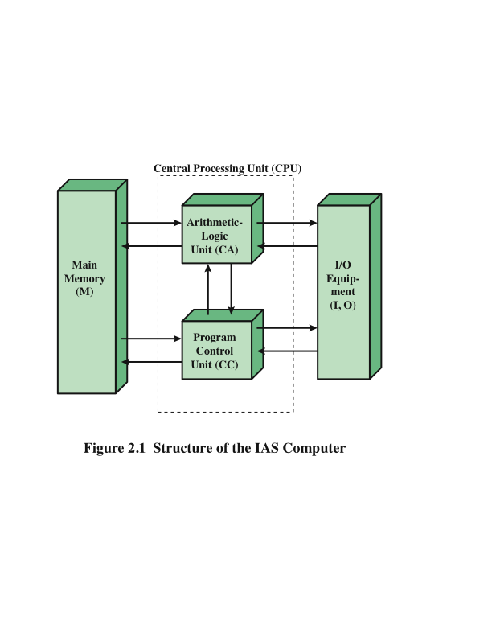
Structure of von Neumann Machine
Notes:
Figure 2.1 shows the general structure of the IAS computer (compare to middle
portion of Figure 1.4). It consists of
• A main memory, which stores both data and instructions
• An arithmetic and logic unit (ALU) capable of operating on binary data
• A control unit, which interprets the instructions in memory and causes them
to be executed
• Input/output (I/O) equipment operated by the control unit

Slide 7
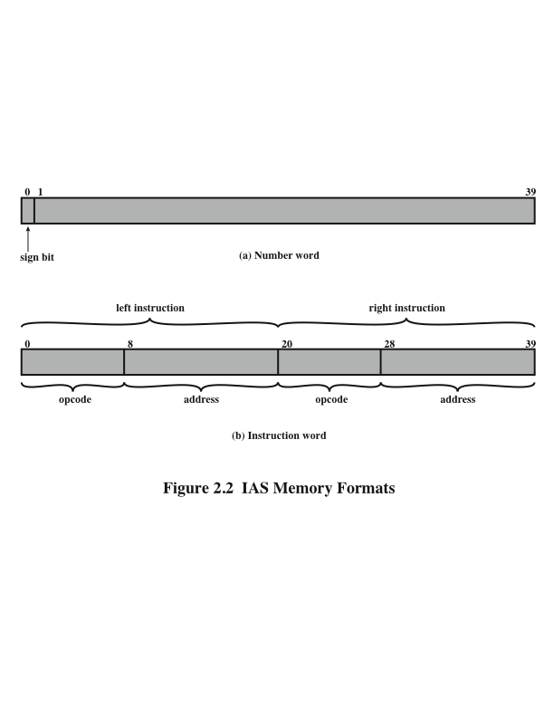
IAS Memory Formats
Both data and instructions are stored there
Numbers are represented in binary form and each instruction is a binary code
The memory of the IAS consists of 1000 storage locations (called words) of 40 bits each
Notes:
The memory of the IAS consists of 1000 storage locations, called words, of
40 binary digits (bits) each. Both data and instructions are stored there. Numbers
are represented in binary form, and each instruction is a binary code. Figure 2.2
illustrates these formats. Each number is represented by a sign bit and a 39-bit
value. A word may also contain two 20-bit instructions, with each instruction
Consisting of an 8-bit operation code (opcode) specifying the operation to be
Performed and a 12-bit address designating one of the words in memory (numbered
from 0 to 999).

Slide 8
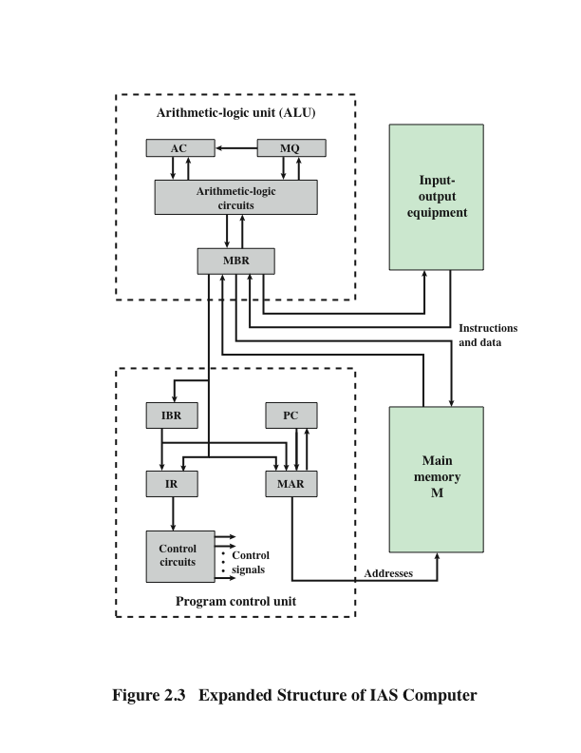
Structure of IAS Computer
Notes:
The control unit operates the IAS by fetching instructions from memory and
executing them one at a time. To explain this, a more detailed structure diagram is
needed, as indicated in Figure 2.3. This figure reveals that both the control unit and
the ALU contain storage locations, called registers.

Slide 9
Registers
Memory buffer register (MBR)
Contains a word to be stored in memory or sent to the I/O unit
Or is used to receive a word from memory or from the I/O unit
Memory address register (MAR)
Specifies the address in memory of the word to be written from or read into the MBR
Instruction register (IR)
Contains the 8-bit opcode instruction being executed
Instruction buffer register (IBR)
Employed to temporarily hold the right-hand instruction from a word in memory
Program counter (PC)
Contains the address of the next instruction pair to be fetched from memory
Accumulator (AC) and multiplier quotient (MQ)
Employed to temporarily hold operands and results of ALU operations
Notes:
Memory buffer register (MBR): Contains a word to be stored in memory or sent
to the I/O unit, or is used to receive a word from memory or from the I/O unit.
• Memory address register (MAR): Specifies the address in memory of the word
to be written from or read into the MBR.
• Instruction register (IR ): Contains the 8-bit opcode instruction being executed.
• Instruction buffer register (IBR): Employed to hold temporarily the right-hand
instruction from a word in memory.
• Program counter (PC): Contains the address of the next instruction pair to be
fetched from memory.
• Accumulator (AC) and multiplier quotient (MQ): Employed to hold temporarily
operands and results of ALU operations. For example, the result of
multiplying two 40-bit numbers is an 80-bit number; the most significant 40 bits
are stored in the AC and the least significant in the MQ.

Slide 10
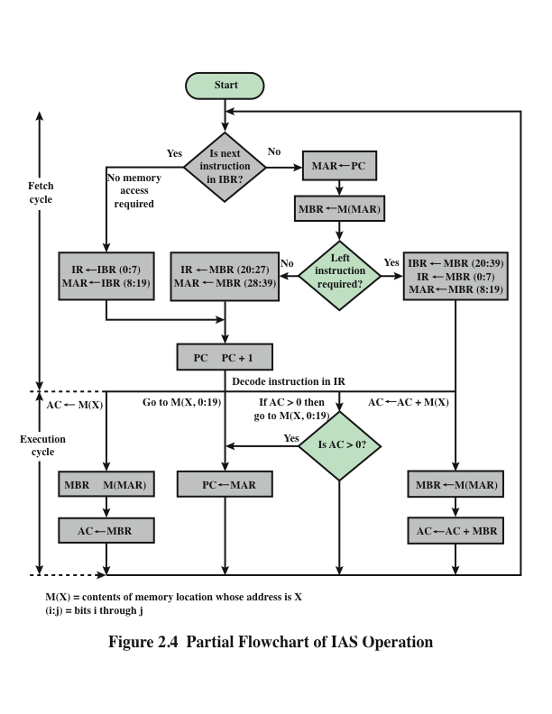
IAS Operations
Notes:
The IAS operates by repetitively performing an instruction cycle, as shown in
Figure 2.4. Each instruction cycle consists of two sub-cycles. During the fetch cycle,
the opcode of the next instruction is loaded into the IR and the address portion is
loaded into the MAR. This instruction may be taken from the IBR, or it can be
obtained from memory by loading a word into the MBR, and then down to the IBR,
IR, and MAR.
Why the indirection? These operations are controlled by electronic circuitry
and result in the use of data paths. To simplify the electronics, there is only one
register that is used to specify the address in memory for a read or write and only
one register used for the source or destination.
Once the opcode is in the IR, the execute cycle is performed. Control circuitry
interprets the opcode and executes the instruction by sending out the appropriate
control signals to cause data to be moved or an operation to be performed by the
ALU.
Figure 2.4 shows several examples of instruction execution by the control unit.
Note that each operation requires several steps. Some of these are quite elaborate.
The multiplication operation requires 39 suboperations, one for each bit position
except that of the sign bit.

Slide 11

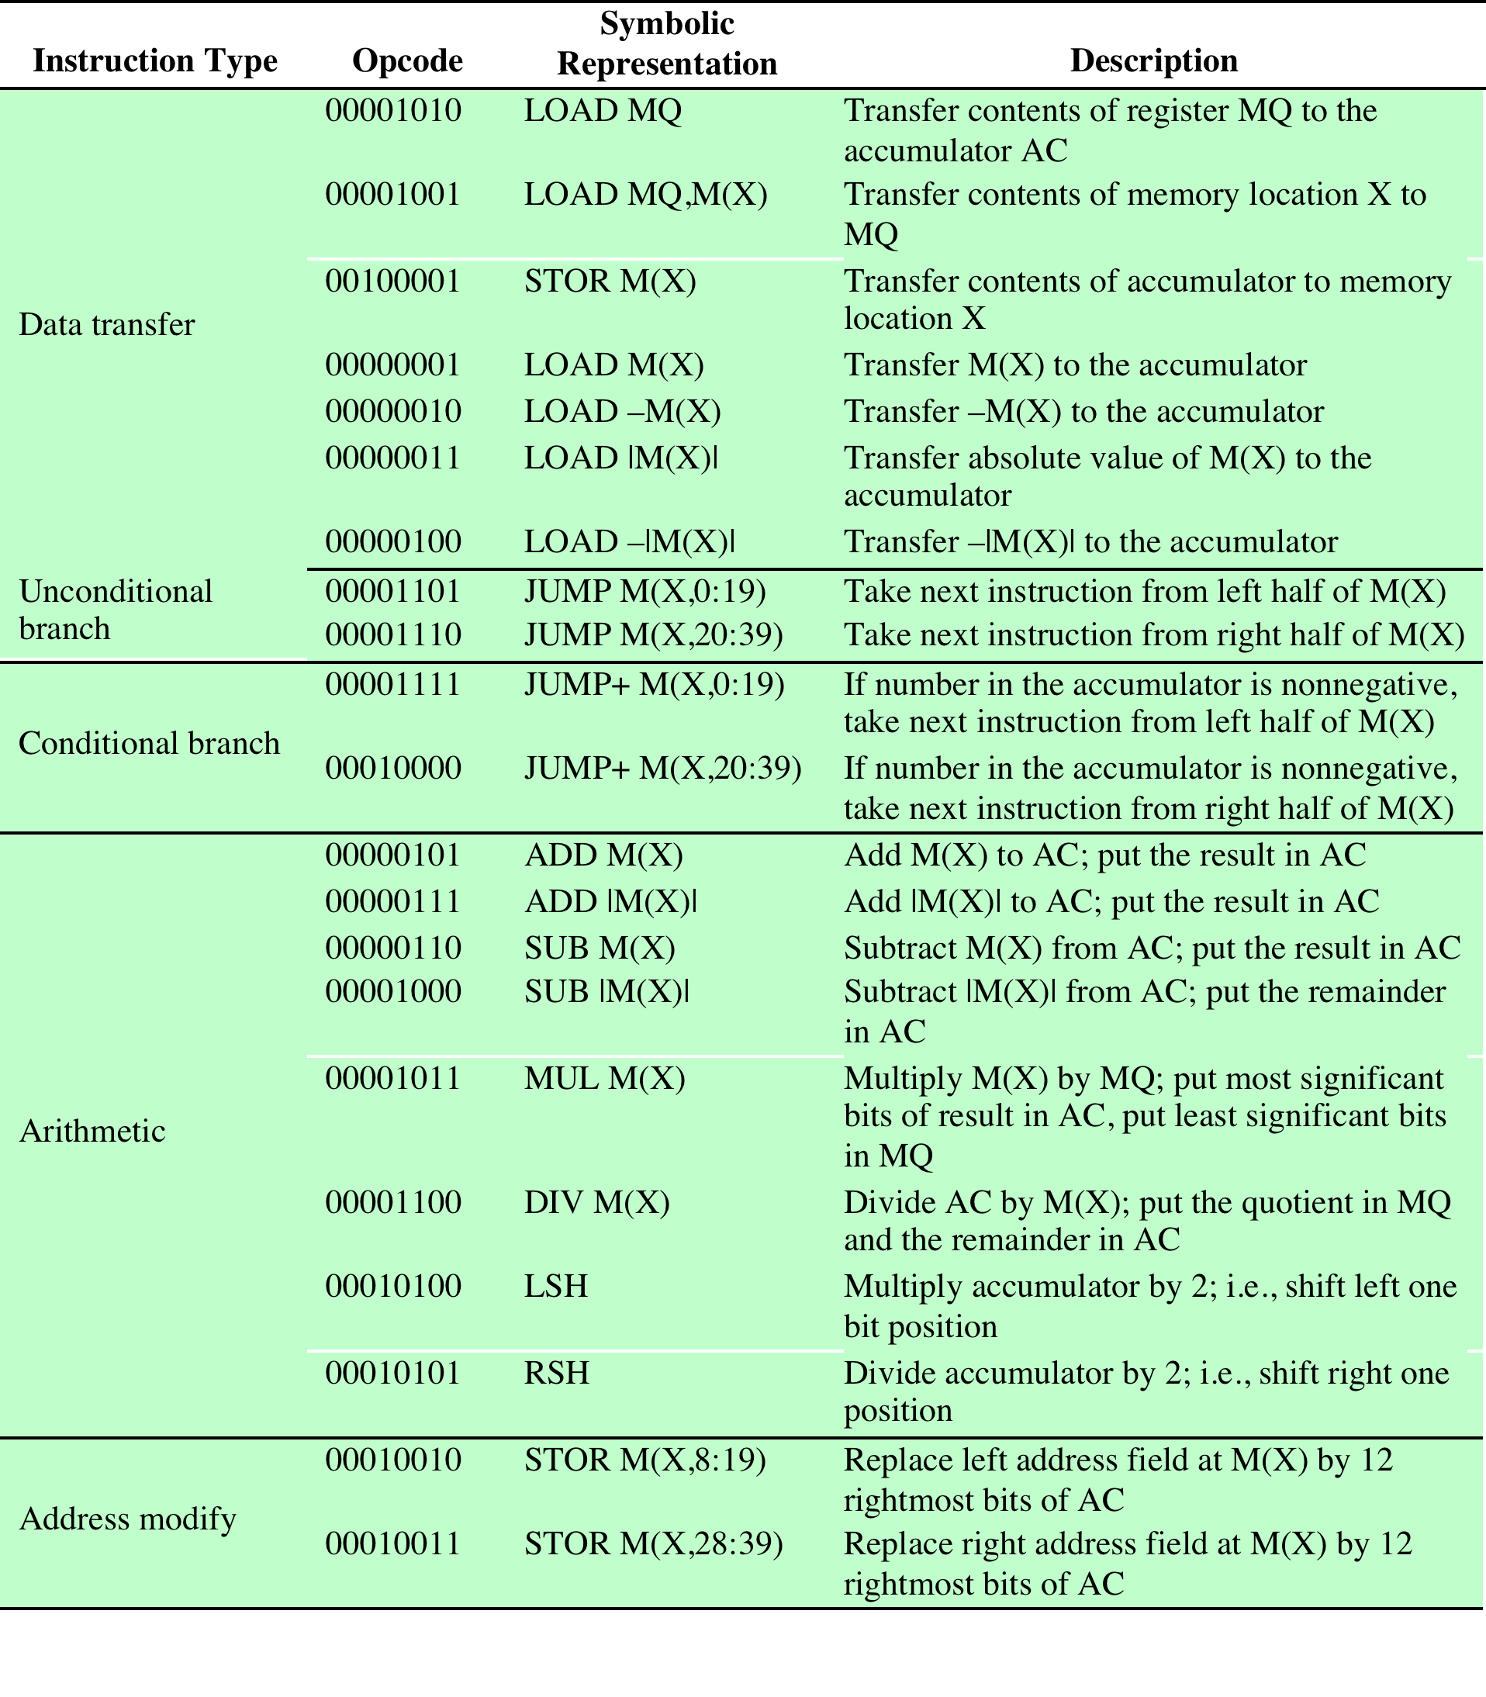
The IAS Instruction Set
Table 2.1
Table 2.1 The IAS Instruction Set
Notes:
The IAS computer had a total of 21 instructions, which are listed in Table 2.1.
These can be grouped as follows:
• Data transfer: Move data between memory and ALU registers or between
two ALU registers.
Unconditional branch: Normally, the control unit executes instructions in
sequence from memory. This sequence can be changed by a branch instruction,
which facilitates repetitive operations.
• Conditional branch: The branch can be made dependent on a condition, thus
allowing decision points.
• Arithmetic: Operations performed by the ALU.
• Address modify: Permits addresses to be computed in the ALU and then
inserted into instructions stored in memory. This allows a program considerable
addressing flexibility.
Table 2.1 presents instructions in a symbolic, easy-to-read form. Actually,
each instruction must conform to the format of Figure 2.2b. The opcode portion
(first 8 bits) specifies which of the 21 instructions is to be executed. The address
portion (remaining 12 bits) specifies which of the 1000 memory locations is to be
involved in the execution of the instruction.

Slide 12
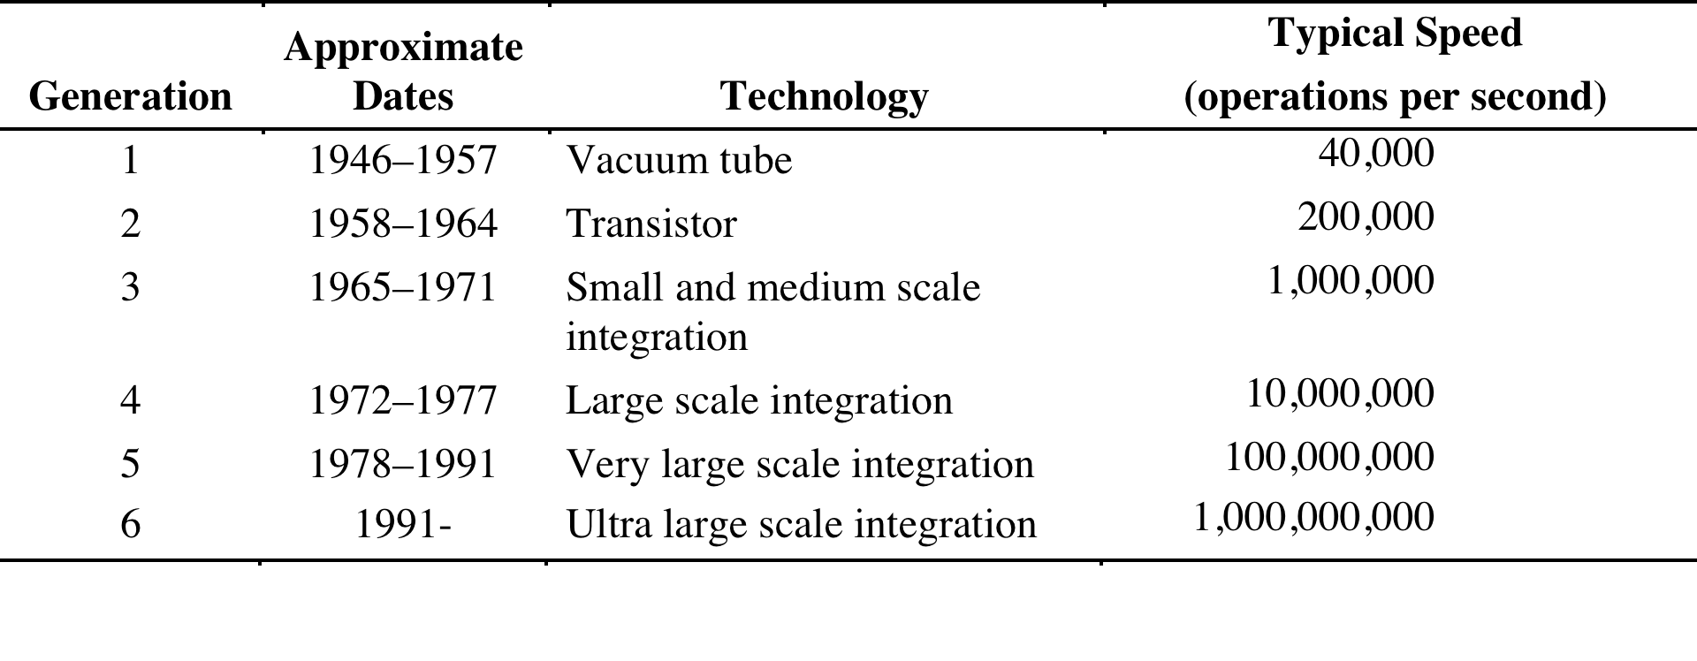
Computer Generations
Table 2.2
Computer Generations
Notes:
It has become widely accepted to classify computers into generations based on the fundamental
hardware technology employed (Table 2.2). Each new generation is characterized
by greater processing performance, larger memory capacity, and smaller
size than the previous one.

Slide 13
Improvements in Chip Organization and Architecture
Increase hardware speed of processor
Fundamentally due to shrinking logic gate size
More gates, packed more tightly, increasing clock rate
Propagation time for signals reduced
Increase size and speed of caches
Dedicating part of processor chip
Cache access times drop significantly
Change processor organization and architecture
Increase effective speed of instruction execution
Parallelism
Notes:
As designers wrestle with the challenge of balancing processor performance with that
of main memory and other computer components, the need to increase processor
speed remains. There are three approaches to achieving increased processor speed:
• Increase the hardware speed of the processor. This increase is fundamentally
due to shrinking the size of the logic gates on the processor chip, so that more
gates can be packed together more tightly and to increasing the clock rate.
With gates closer together, the propagation time for signals is significantly
reduced, enabling a speeding up of the processor. An increase in clock rate
means that individual operations are executed more rapidly.
• Increase the size and speed of caches that are interposed between the processor
and main memory. In particular, by dedicating a portion of the processor
chip itself to the cache, cache access times drop significantly.
• Make changes to the processor organization and architecture that increase the
effective speed of instruction execution. Typically, this involves using parallelism
in one form or another.

Slide 14
Problems with Clock Speed and Login Density
Power
Power density increases with density of logic and clock speed
Dissipating heat
RC delay
Speed at which electrons flow limited by resistance and capacitance of metal wires connecting them
Delay increases as RC product increases
Wire interconnects thinner, increasing resistance
Wires closer together, increasing capacitance
Memory latency
Memory speeds lag processor speeds
Notes:
Traditionally, the dominant factor in performance gains has been in increases
in clock speed due and logic density. However, as clock speed and logic density
increase, a number of obstacles become more significant [INTE04b]:
• Power: As the density of logic and the clock speed on a chip increase, so does
the power density (Watts/cm2). The difficulty of dissipating the heat generated
on high-density, high-speed chips is becoming a serious design issue [GIBB04,
BORK03].
• RC delay: The speed at which electrons can flow on a chip between transistors
is limited by the resistance and capacitance of the metal wires connecting
them; specifically, delay increases as the RC product increases. As components
on the chip decrease in size, the wire interconnects become thinner, increasing
resistance. Also, the wires are closer together, increasing capacitance.
• Memory latency: Memory speeds lag processor speeds, as previously discussed.
Thus, there will be more emphasis on organization and architectural approaches
to improving performance. These techniques are discussed in later chapters of the book.

Slide 15

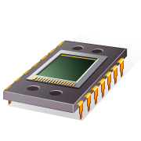
x86 Evolution
8080
First general purpose microprocessor
8-bit machine with an 8-bit data path to memory
Used in the first personal computer (Altair)
8086
16-bit machine
Used an instruction cache, or queue
First appearance of the x86 architecture
8088
used in IBM’s first personal computer
80286
Enabled addressing a 16-MByte memory instead of just 1 MByte
80386
Intel’s first 32-bit machine
First Intel processor to support multitasking
80486
More sophisticated cache technology and instruction pipelining
Built-in math coprocessor
Notes:
It is worthwhile to list some of the highlights of the evolution of the Intel
product line:
• 8080: The world’s first general-purpose microprocessor. This was an 8-bit
machine, with an 8-bit data path to memory. The 8080 was used in the first
personal computer, the Altair.
• 8086: A far more powerful, 16-bit machine. In addition to a wider data path
and larger registers, the 8086 sported an instruction cache, or queue, that
prefetches a few instructions before they are executed. A variant of this
processor, the 8088, was used in IBM’s first personal computer, securing the
success of Intel. The 8086 is the first appearance of the x86 architecture.
• 80286: This extension of the 8086 enabled addressing a 16-MByte memory
instead of just 1 MByte.
• 80386: Intel’s first 32-bit machine, and a major overhaul of the product.
With a 32-bit architecture, the 80386 rivaled the complexity and power of
minicomputers and mainframes introduced just a few years earlier. This was
the first Intel processor to support multitasking, meaning it could run multiple
programs at the same time.
80486: The 80486 introduced the use of much more sophisticated and powerful
cache technology and sophisticated instruction pipelining. The 80486 also
offered a built-in math coprocessor, offloading complex math operations from
the main CPU.

Slide 16
x86 Evolution - Pentium
Pentium
Superscalar
Multiple instructions executed in parallel
Pentium Pro
Increased superscalar organization
Aggressive register renaming
Branch prediction
Data flow analysis
Speculative execution
Pentium II
MMX technology
Designed specifically to process video, audio, and graphics data
Pentium III
Additional floating-point instructions to support 3D graphics software
Pentium 4
Includes additional floating-point and other enhancements for multimedia
Notes:
• Pentium: With the Pentium, Intel introduced the use of superscalar techniques,
which allow multiple instructions to execute in parallel.
• Pentium Pro: The Pentium Pro continued the move into superscalar organization
begun with the Pentium, with aggressive use of register renaming, branch
prediction, data flow analysis, and speculative execution.
• Pentium II : The Pentium II incorporated Intel MMX technology, which is
designed specifically to process video, audio, and graphics data efficiently.
• Pentium III : The Pentium III incorporates additional floating-point instructions
to support 3D graphics software.
• Pentium 4: The Pentium 4 includes additional floating-point and other
enhancements for multimedia.

Slide 17
x86 Evolution (continued)
Core
First Intel x86 microprocessor with a dual core, referring to the implementation of two processors on a single chip
Core 2
Extends the architecture to 64 bits
Recent Core offerings have up to 10 processors per chip
Instruction set architecture is backward compatible with earlier versions
X86 architecture continues to dominate the processor market outside of embedded systems
Notes:
Core: This is the first Intel x86 microprocessor with a dual core, referring to
the implementation of two processors on a single chip.
• Core 2: The Core 2 extends the architecture to 64 bits. The Core 2 Quad provides
four processors on a single chip. More recent Core offerings have up to
10 processors per chip.
Over 30 years after its introduction in 1978, the x86 architecture continues to
dominate the processor market outside of embedded systems. Although the organization
and technology of the x86 machines have changed dramatically over the decades,
the instruction set architecture has evolved to remain backward compatible
with earlier versions. Thus, any program written on an older version of the x86 architecture
can execute on newer versions. All changes to the instruction set architecture
have involved additions to the instruction set, with no subtractions. The rate of
change has been the addition of roughly one instruction per month added to the
architecture over the 30 years [ANTH08], so that there are now over 500 instructions
in the instruction set.
The x86 provides an excellent illustration of the advances in computer
hardware over the past 30 years. The 1978 8086 was introduced with a clock speed
of 5 MHz and had 29,000 transistors. A quad-core Intel Core 2 introduced in 2008
operates at 3 GHz, a speedup of a factor of 600, and has 820 million transistors,
about 28,000 times as many as the 8086. Yet the Core 2 is in only a slightly larger
package than the 8086 and has a comparable cost.

Slide 18

General definition:
“A combination of computer
hardware and software, and perhaps additional mechanical or other parts, designed to perform a dedicated function. In many cases, embedded systems are part of a larger system or product, as in the case of an antilock braking system in a car.”
Embedded
Systems
Notes:
The term embedded system refers to the use of electronics and software within a
product, as opposed to a general-purpose computer, such as a laptop or desktop
system. The following is a good general definition:
Embedded system. A combination of computer hardware and software, and perhaps
additional mechanical or other parts, designed to perform a dedicated function. In many
cases, embedded systems are part of a larger system or product, as in the case of an antilock
braking system in a car.

Slide 19
Amdahl’s Law
Gene Amdahl [AMDA67]
Deals with the potential speedup of a program using multiple processors compared to a single processor
Illustrates the problems facing industry in the development of multi-core machines
Software must be adapted to a highly parallel execution environment to exploit the power of parallel processing
Can be generalized to evaluate and design technical improvement in a computer system
Notes:
When considering system performance, computer system designers look for
ways to improve performance by improvement in technology or change in
design. Examples include the use of parallel processors, the use of a memory
cache hierarchy, and speedup in memory access time and I/O transfer rate
due to technology improvements. In all of these cases, it is important to note
that a speedup in one aspect of the technology or design does not result in a
corresponding improvement in performance. This limitation is succinctly
expressed by Amdahl’s law.
Amdahl’s law was first proposed by Gene Amdahl in [AMDA67] and deals
with the potential speedup of a program using multiple processors compared to a
single processor.
Amdahl’s law illustrates the problems facing industry in the development of multi-core
machines with an ever-growing number of cores: The software that runs on such
machines must be adapted to a highly parallel execution environment to exploit the
power of parallel processing.

Slide 20
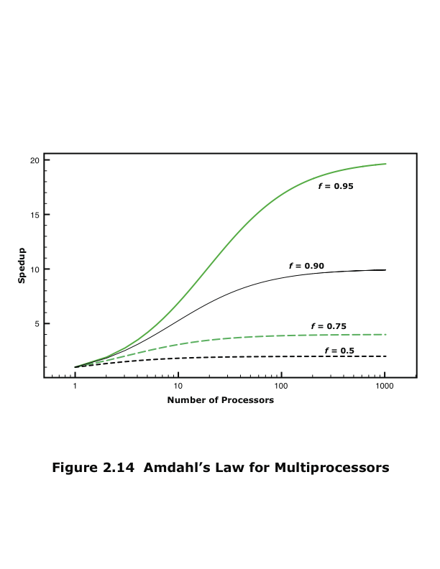
Amdahl’s Law
Notes:
Consider a program running on a single processor such that a fraction
(1 – f) of the execution time involves code that is inherently serial and a fraction
f that involves code that is infinitely parallelizable with no scheduling overhead.
Let T be the total execution time of the program using a single processor. Then the
speedup using a parallel processor with N processors that fully exploits the parallel
portion of the program is as follows:
Speedup =
Time to execute program on a single processor
Time to execute program on N parallel processors
=T(1 - f) + Tf
T(1 - f) +Tf
N
= 1
(1 - f) +f
N
This equation is illustrated in Figure 2.14. Two important conclusions can be
drawn:
1. When f is small, the use of parallel processors has little effect.
2. As N approaches infinity, speedup is bound by 1/(1 – f), so that there are
diminishing returns for using more processors.
These conclusions are too pessimistic, an assertion first put forward in
[GUST88]. For example, a server can maintain multiple threads or multiple tasks
to handle multiple clients and execute the threads or tasks in parallel up to the limit
of the number of processors. Many database applications involve computations on
massive amounts of data that can be split up into multiple parallel tasks.

Slide 21
Little’s Law
Fundamental and simple relation with broad applications
Can be applied to almost any system that is statistically in steady state, and in which there is no leakage
Queuing system
If server is idle an item is served immediately, otherwise an arriving item joins a queue
There can be a single queue for a single server or for multiple servers, or multiples queues with one being for each of multiple servers
Average number of items in a queuing system equals the average rate at which items arrive multiplied by the time that an item spends in the system
Relationship requires very few assumptions
Because of its simplicity and generality it is extremely useful
Notes:
A fundamental and simple relation with broad applications is Little’s Law
[LITT61, LITT11]. We can apply it to almost any system that is statistically in
steady state, and in which there is no leakage.
Using queuing theory terminology, Little’s Law applies to a queuing system.
The central element of the system is a server, which provides some service to items.
Items from some population of items arrive at the system to be served. If the server
is idle, an item is served immediately. Otherwise, an arriving item joins a waiting
line, or queue. There can be a single queue for a single server, a single queue for
multiple servers, or multiples queues, one for each of multiple servers. When a
server has completed serving an item, the item departs. If there are items waiting in
the queue, one is immediately dispatched to the server. The server in this model can
represent anything that performs some function or service for a collection of items.
Examples: A processor provides service to processes; a transmission line provides a
transmission service to packets or frames of data; and an I/O device provides a read
or write service for I/O requests.
The average number of items in a queuing system equals the average rate at which items arrive multiplied by the average time that an item spends in the system. This relationship requires very few assumptions. We do not need to know what the service time distribution is, what
the distribution of arrival times is, or the order or priority in which items are served.
Because of its simplicity and generality, Little’s Law is extremely useful and has
experienced somewhat of a revival due to the interest in performance problems
related to multi-core computers.

